Slide 1

INVENTORY MANGEMENT SYSTEM
YOGESH KANNAN.V

Slide 2
INTRODUCTION
An Inventory Management System (IMS) efficiently tracks and manages a company's inventory, ensuring optimal stock levels, reducing holding costs, and enhancing order fulfillment. By automating processes, it improves accuracy, minimizes human error, and supports strategic decision-making through real-time data analysis and reporting.

Slide 3
EXISTING SOLUTION
The existing solution for inventory management often relies on manual processes and outdated systems, leading to inefficiencies and errors. These systems lack real-time tracking and analytics, making it difficult to maintain optimal stock levels and accurately forecast demand. This results in increased costs and poor inventory control.

Slide 4
PROPOSED SOLUTION
The proposed system streamlines inventory management by integrating advanced tracking, automated restocking, and real-time analytics. It enhances efficiency, reduces manual errors, and ensures optimal stock levels. With user-friendly interfaces and robust reporting tools, the system supports informed decision-making and improves overall operational performance.

Slide 5
Software requirement
Front End: HTML,CSS,JAVASCRIPT,REACT.JS
Back End: NODE.JS,EXPESS.JS
Database: MONGODB

Slide 6
Modules
HOME MODULE
INVENTORY MODULE
ORDER MODULE
GROWTH MODULE

Slide 7
HOME MODULE DESCRIPTION
The Home Module of the Inventory Management System provides a centralized dashboard for users to access key functions, view real-time inventory data, and monitor system alerts. It offers a user-friendly interface for quick navigation, streamlining operations and enhancing user experience by centralizing essential information and tools in one location.

Slide 8
INVENTORY MODULE
The Inventory Module of the Inventory Management System allows users to track and manage stock levels, update item details, and monitor inventory movements. It provides real-time insights into inventory status, facilitates reorder alerts, and supports efficient stock control, ensuring optimal inventory levels and reducing shortages or overstock situations.

Slide 9
ORDER MODULE
The Order Module of the Inventory Management System streamlines the process of creating, tracking, and managing purchase and sales orders. It ensures efficient order processing, monitors order status in real-time, and integrates with inventory data to maintain accurate stock levels, thereby enhancing customer satisfaction and operational efficiency.

Slide 10
GROWTH MODULE
The Growth Module of the Inventory Management System focuses on analyzing trends and forecasting future inventory needs. It leverages historical data and market analysis to predict demand, identify growth opportunities, and optimize stock levels. This module supports strategic planning and scalability, helping businesses to expand efficiently while maintaining optimal inventory control.

Slide 11
OUTPUT

Slide 12
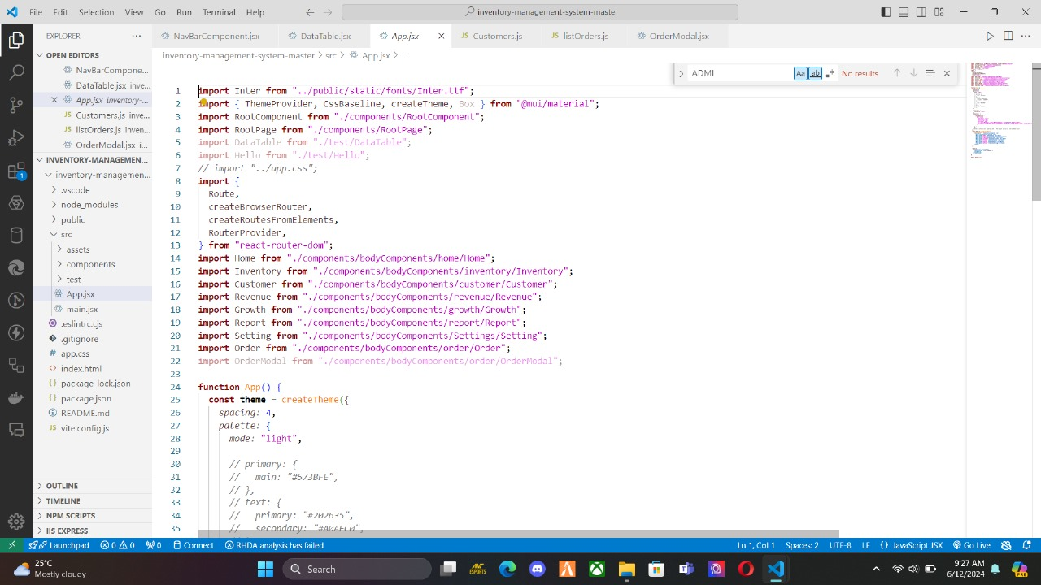
SAMPLE CODE

Slide 13
SAMPLE CODE

Slide 14
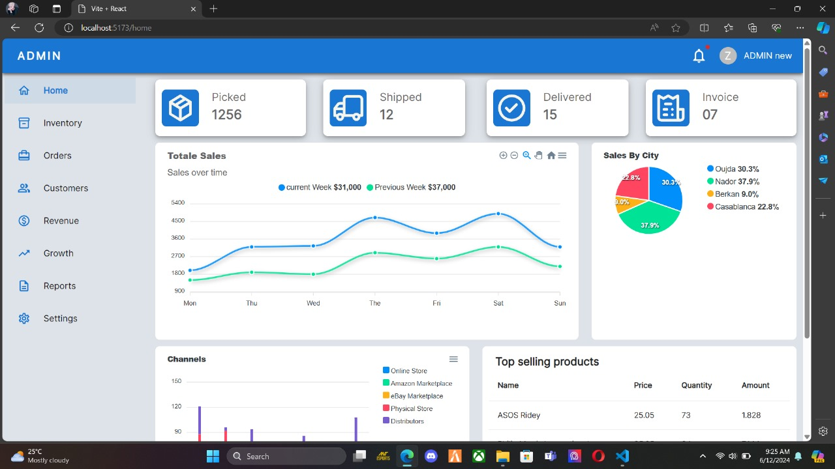

Slide 15
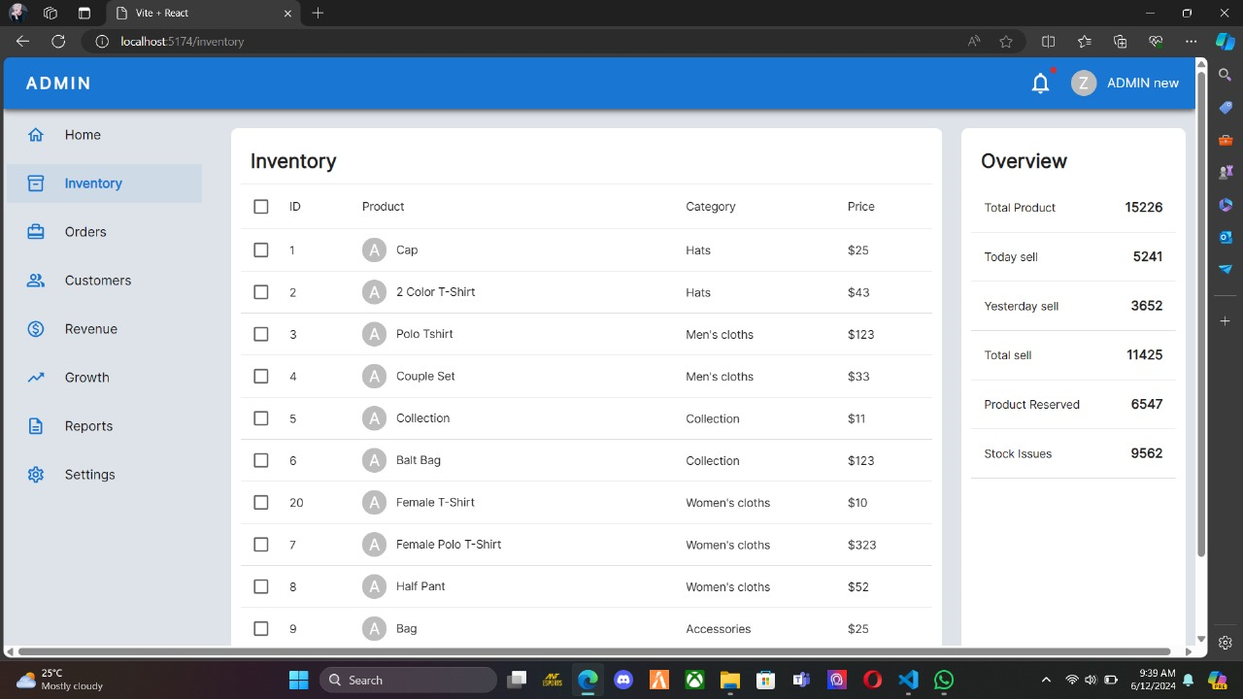

Slide 16
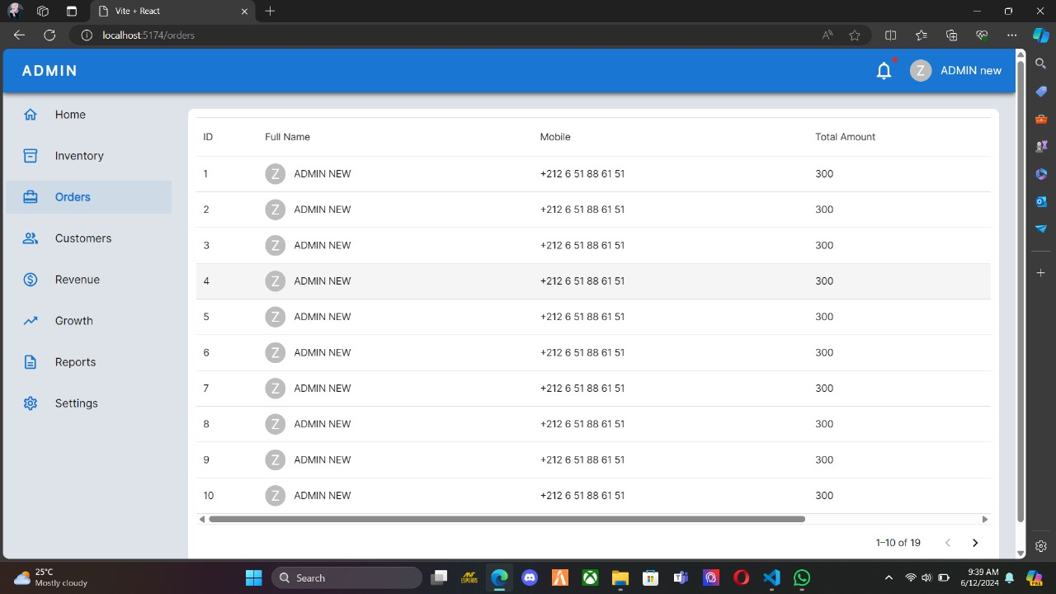

Slide 17
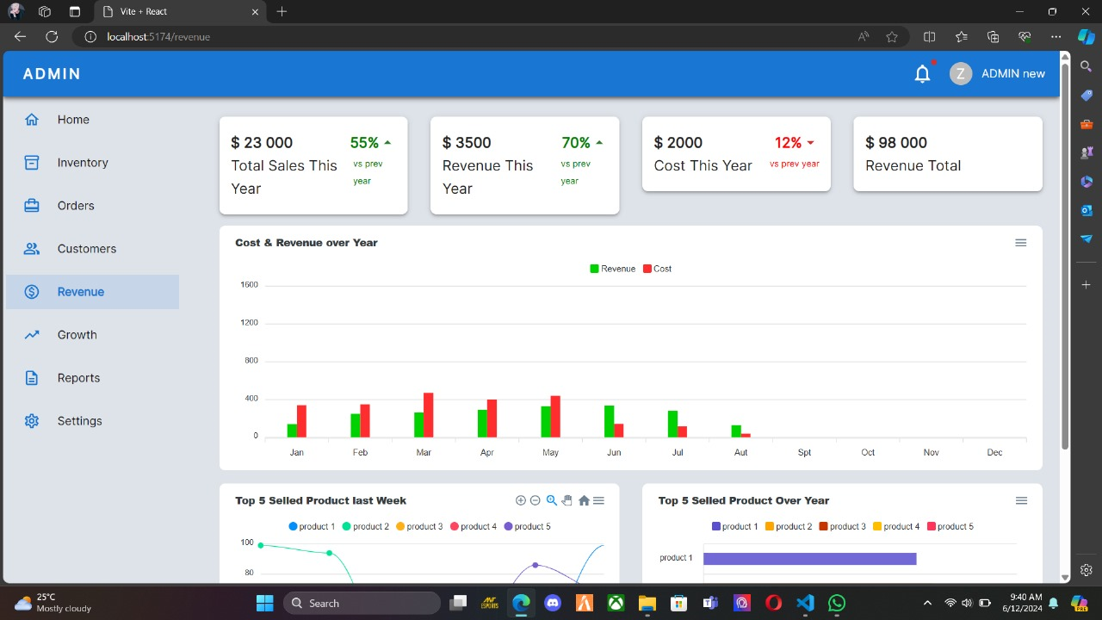

Slide 18
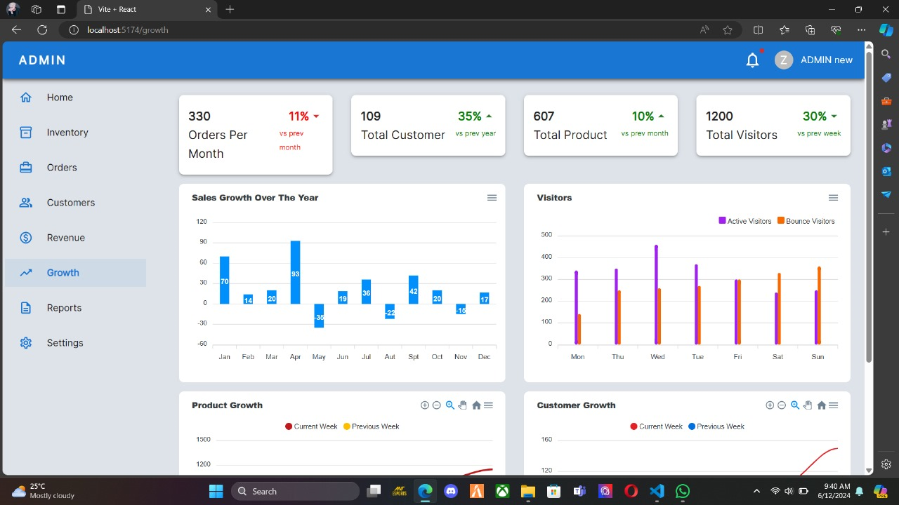

Slide 19


